Slide 1
AI-Powered Smart Energy Consumption Monitoring and Optimization System
AI for Sustainability Virtual Internship (1M1B – IBM SkillsBuild)
Capstone Project
Madhumitha Samala
madhumithasaamala@gmail.com
AICTE STUDENT ID: STU664b45d349dca1716209107

Slide 2
Introduction
Energy consumption is increasing rapidly due to urbanization, population growth, and excessive use of electrical appliances. Inefficient energy usage leads to higher electricity costs and increased carbon emissions. There is a strong need for intelligent systems that can monitor, analyze, and optimize energy usage to promote sustainability. Artificial Intelligence can play a key role in understanding consumption patterns and supporting energy-efficient decision-making.

Slide 3
Problem Statement
Traditional energy monitoring systems lack predictive capability and real-time insights. Users are often unaware of how factors like temperature, occupancy, and time affect energy usage. This results in energy wastage, high electricity bills, and environmental impact. There is a need for an AI-based solution that can predict energy consumption, analyze trends, and provide cost and sustainability insights.

Slide 4
Objectives
To predict energy consumption using AI
To analyze energy usage trends
To estimate electricity cost
To provide sustainability-driven insights
To support energy-efficient decision-making

Slide 5
SDG Alignment
Primary SDG:
SDG 7 – Affordable and Clean Energy
Secondary SDG:
SDG 13 – Climate Action
This project promotes efficient energy usage, reduces wastage, and supports climate-friendly practices.

Slide 6
Dataset Description
Dataset size: 250 records (CSV Format)
Features used:
  Temperature
  Humidity
  Occupancy
  Hour of the day
  Weekend indicator
Target variable: Energy consumption

Slide 7
Role of AI in the Project
  Artificial Intelligence is used to:
  Learn patterns from historical energy data
  Predict future energy consumption
  Analyze the impact of external factors
  Support intelligent decision-making
  Provide actionable insights for sustainability
  A Random Forest Regression model is used for prediction.

Slide 8
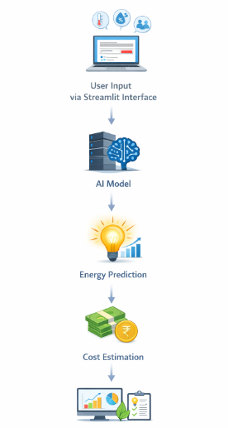
System Architecture
Workflow:
User provides input through Streamlit interface
Input data is passed to trained AI model
Model predicts energy consumption
Cost estimation is calculated
Dynamic graphs and insights are generated

Slide 9
Implementation Details
Programming Language: Python
Frontend: Streamlit
AI Model: Random Forest Regressor
Visualization: Matplotlib
Model Storage: Joblib

Slide 10
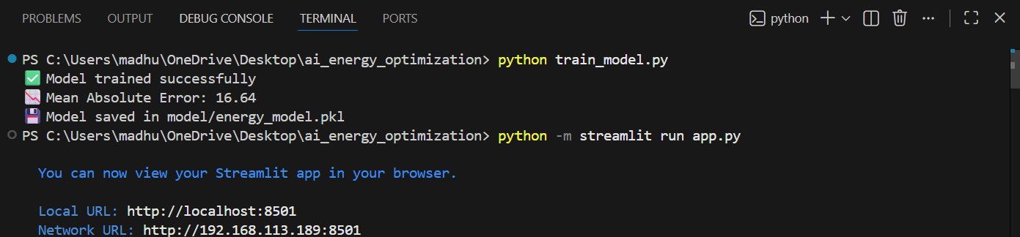
Output Screens

Slide 11
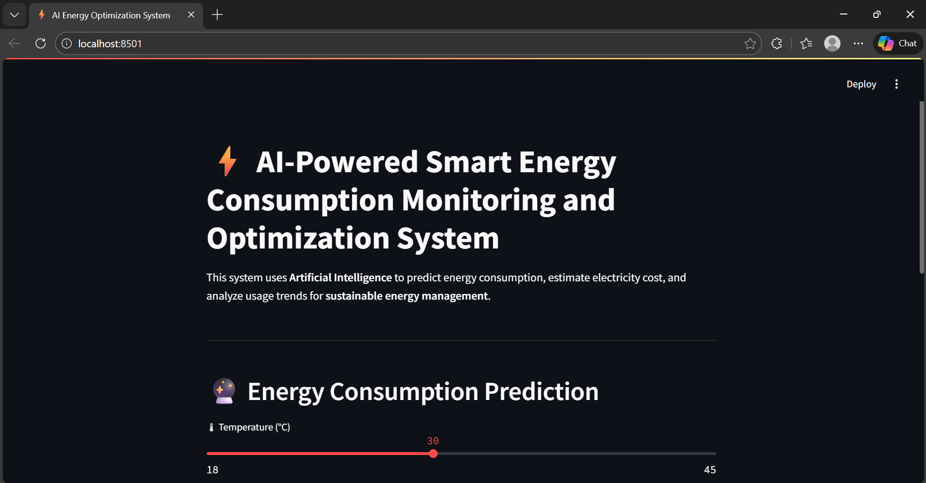

Slide 12
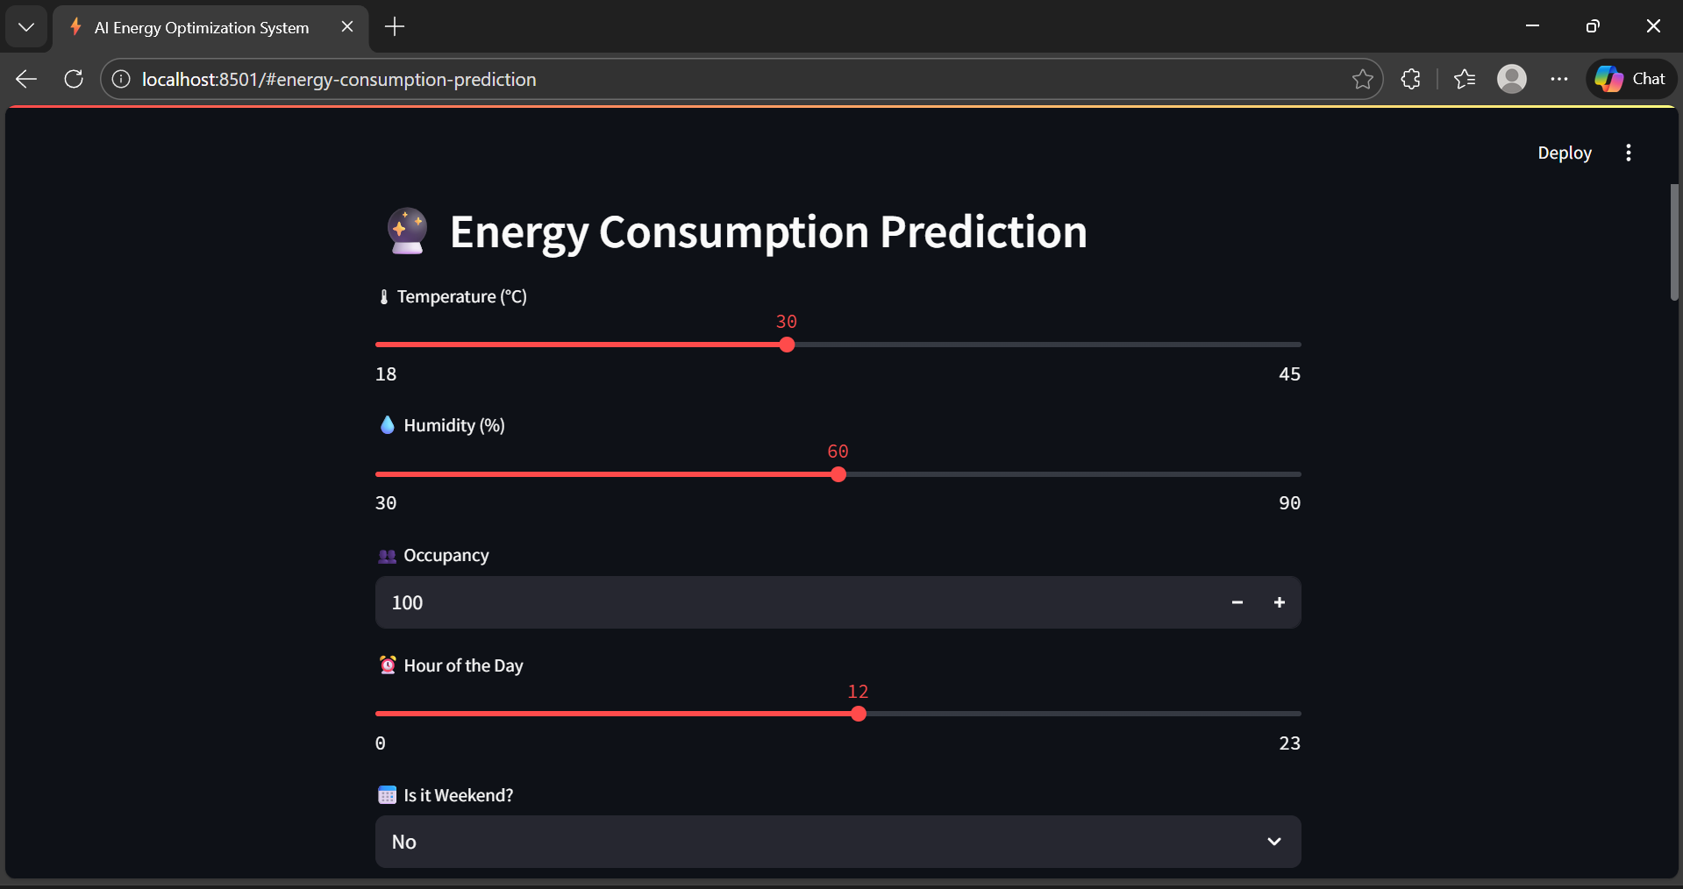

Slide 13
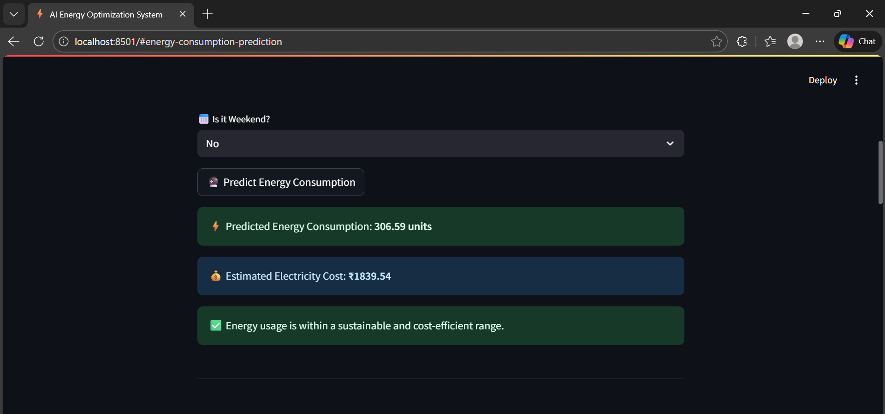

Slide 14
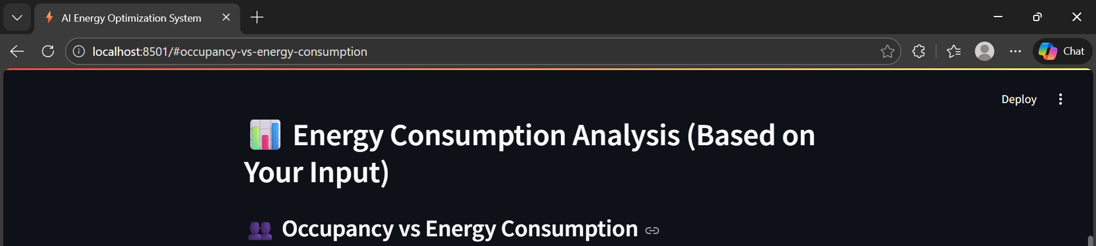
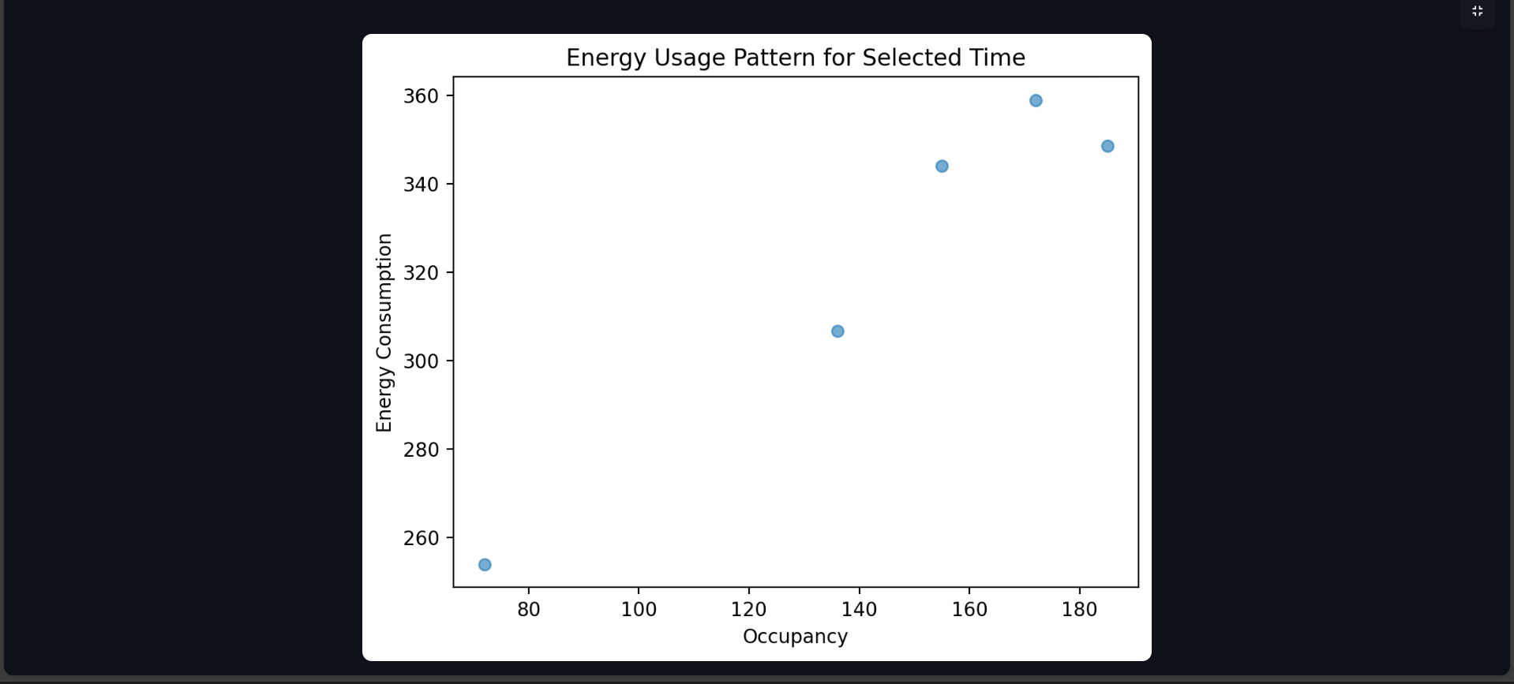

Slide 15
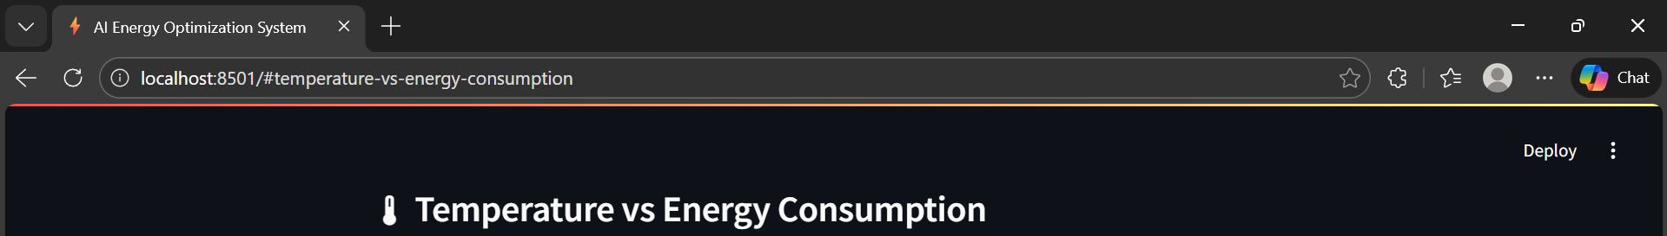
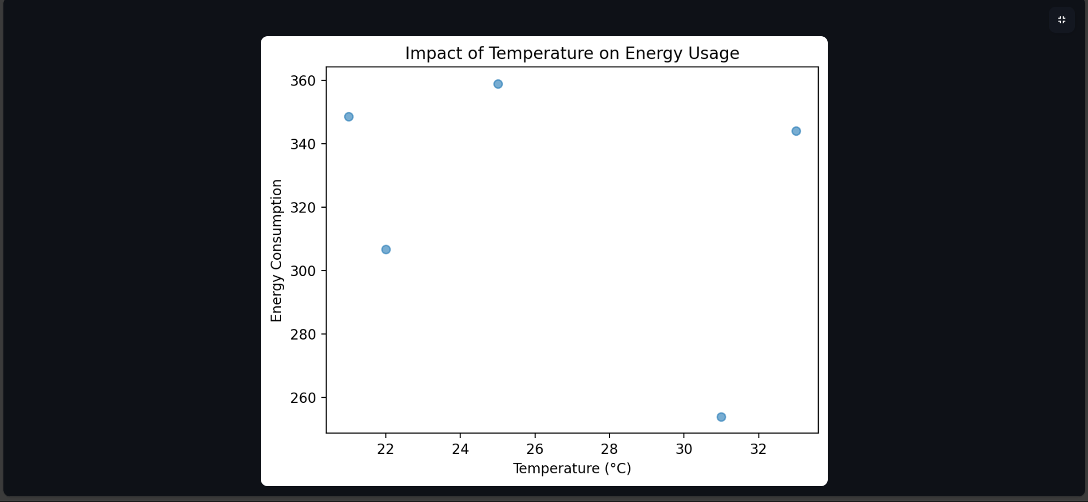

Slide 16
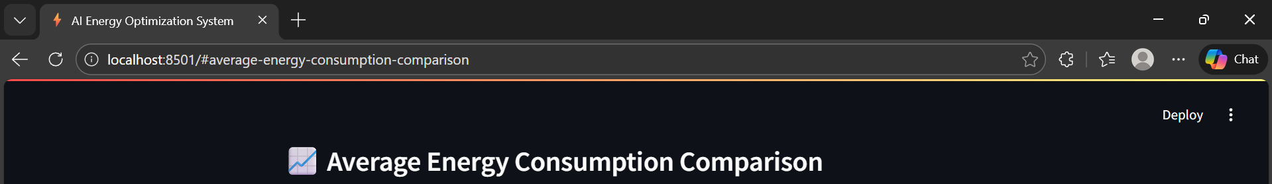
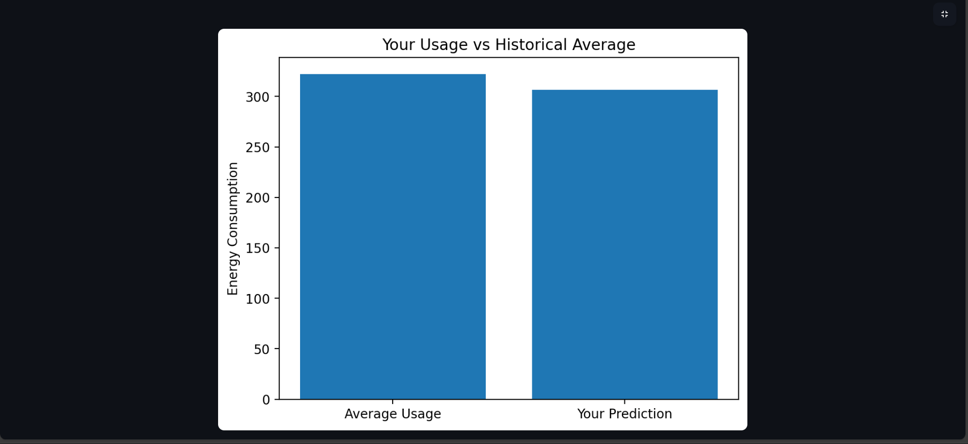

Slide 17
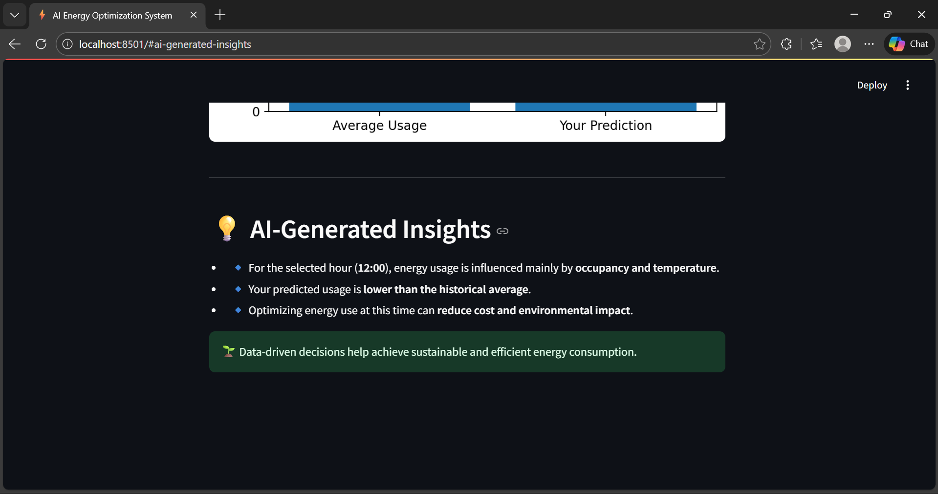
DEMO: https://drive.google.com/file/d/1I_0oh3ujxW2k-hS8ZoYFjM9PzyFApDH0/view?usp=sharing

Slide 18
Features of the System
AI-based energy prediction
Interactive Streamlit interface
Dynamic energy consumption graphs
Trend analysis based on user input
Electricity cost estimation
Sustainability recommendations

Slide 19
Visualization & Analysis
Hour-wise energy consumption trends
Occupancy vs energy usage analysis
Temperature impact on energy usage
Comparison of predicted usage with historical average

Slide 20
Cost Estimation Feature
Electricity cost assumed: ₹6 per unit
Cost is calculated based on predicted energy usage
Helps users understand financial impact
Encourages energy-efficient behavior
This links sustainability with economic awareness.

Slide 21
Responsible AI Considerations
Fairness: Uses unbiased, synthetic data
Transparency: Model logic and outputs are explainable
Privacy: No personal or sensitive data used
Ethics: Used only for sustainability and awareness

Slide 22
Results & Impact
Accurate energy consumption prediction
Better understanding of usage patterns
Reduction in energy wastage
Lower electricity costs
Positive environmental impact

Slide 23
Future Scope
Integration with real-time IoT sensors
Carbon footprint estimation
Mobile application support
Smart alerts and notifications
Deployment for large buildings and campuses

Slide 24
Conclusion
The project demonstrates how AI can be effectively used to monitor and optimize energy consumption. By combining prediction, visualization, cost estimation, and sustainability insights, the system supports responsible energy usage. This solution highlights the role of AI as a powerful tool for sustainable development.

